Slide 1
Google Scholar Citations
Hawler Medical University

Slide 2
How to open an account
scholar.google.com
Sign in with your gmail account
Provide your information (hmu email if available)
Check and add your articles
Edit your profile (photo, make your profile public)
Verify your “hmu” email
Create alerts
Understand the citation indices
Search Google Scholar

Slide 3
How to open an account
scholar.google.com
Sign in with your gmail account
Provide your information (hmu email if available)
Check and add your articles
Edit your profile (photo, make your profile public)
Verify your “hmu” email
Create alerts
Understand the citation indices
Search Google Scholar

Slide 4
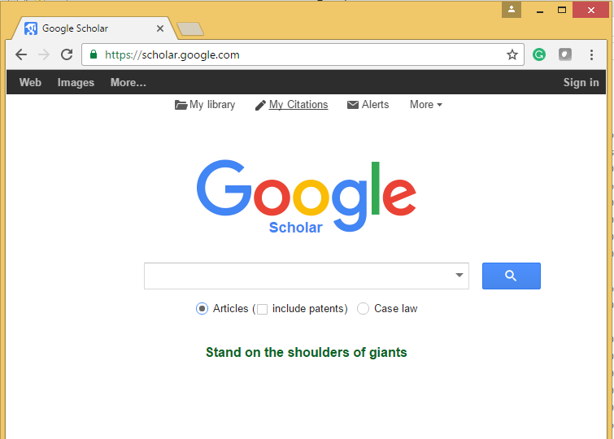
- scholar.google.com - My citations

Slide 5
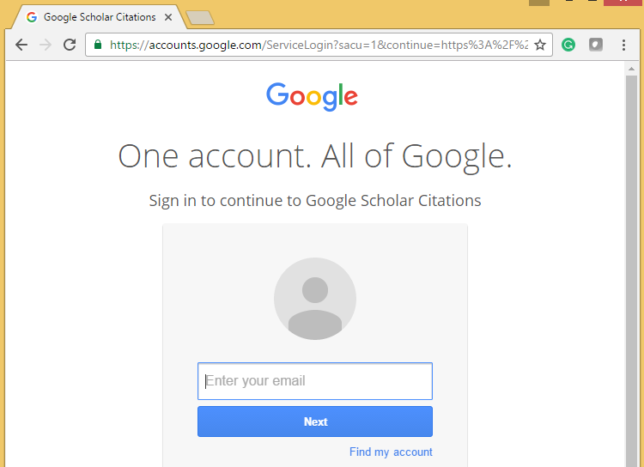
Sign in with your gmail account

Slide 6
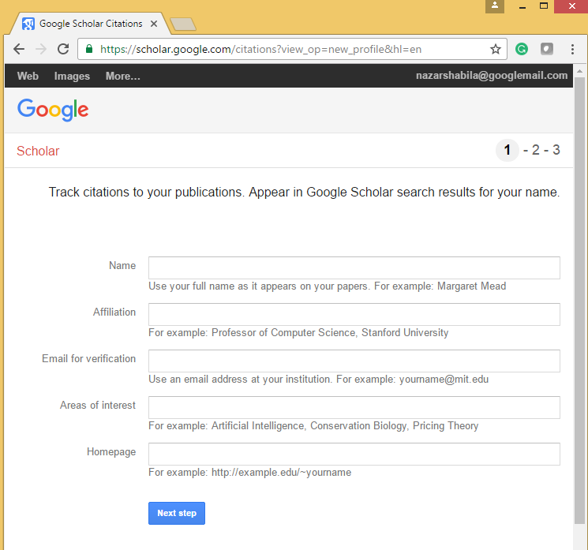
Provide your information
Name: as appear in your publications
Affiliation: Provide full information;
Scientific title, Department, College, Hawler Medical University, Erbil, Kurdistan, Iraq
Please write Hawler Medical University in full words without abbreviations or spelling mistakes
Email: university/college email (@med.hmu.edu.iq)

Slide 7
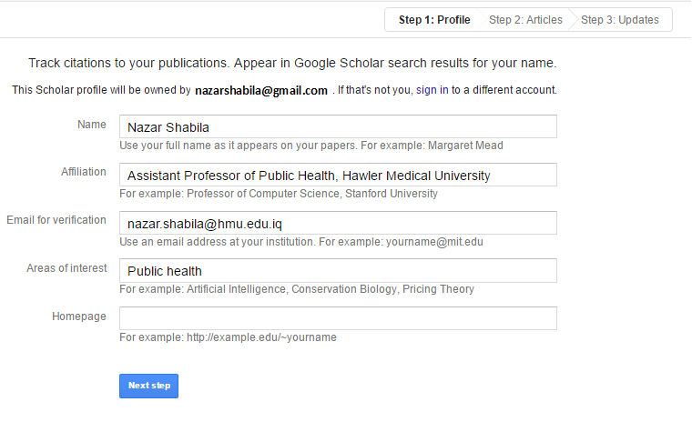
Provide your information
Provide full info to enhance the search function of your name and profile
Assistant Professor, Department of Community Medicine, College of Medicine, Hawler Medical University, Erbil, Kurdistan region, Iraq

Slide 8
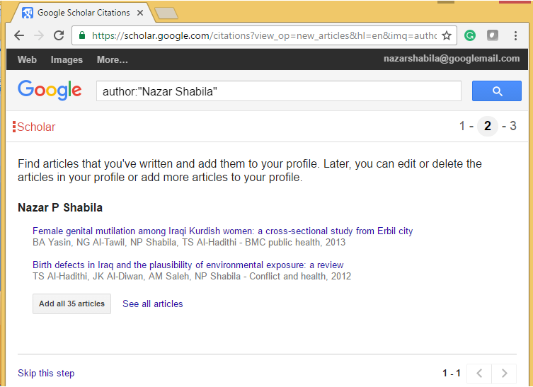
Check and add your articles
To avoid the problem of similar names, common names

Slide 9
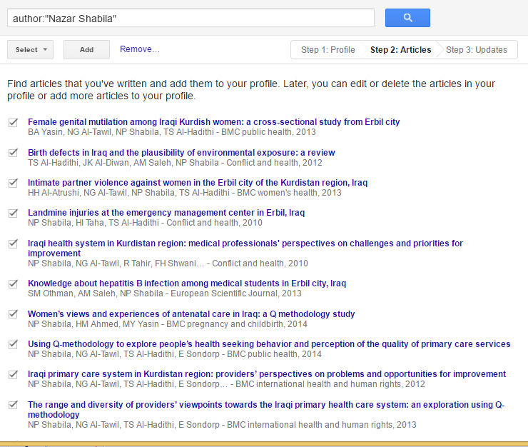

Slide 10
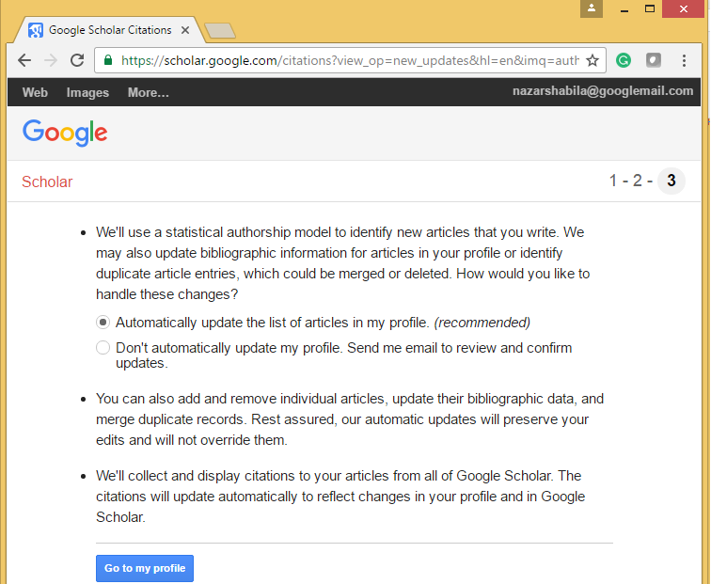

Slide 11
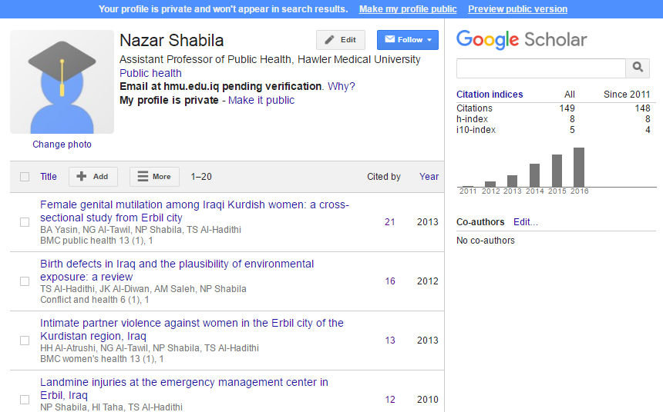
Your account is now created Edit your profile

Slide 12
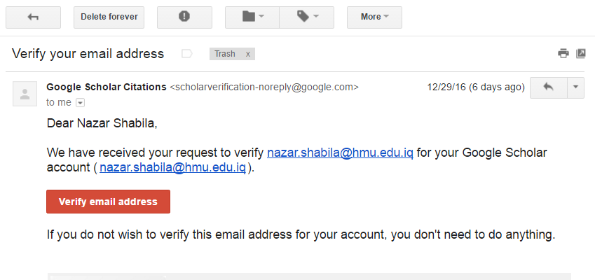
Verify your email Open your university/college email

Slide 13
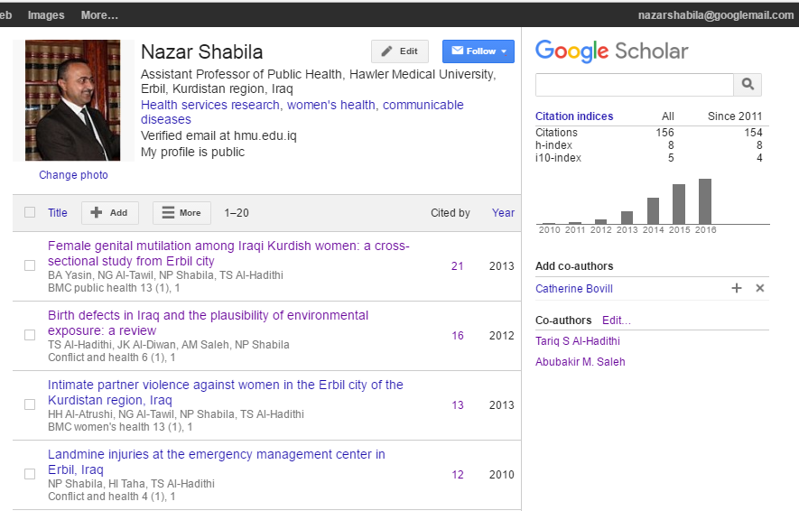
Create alerts (optional)

Slide 14
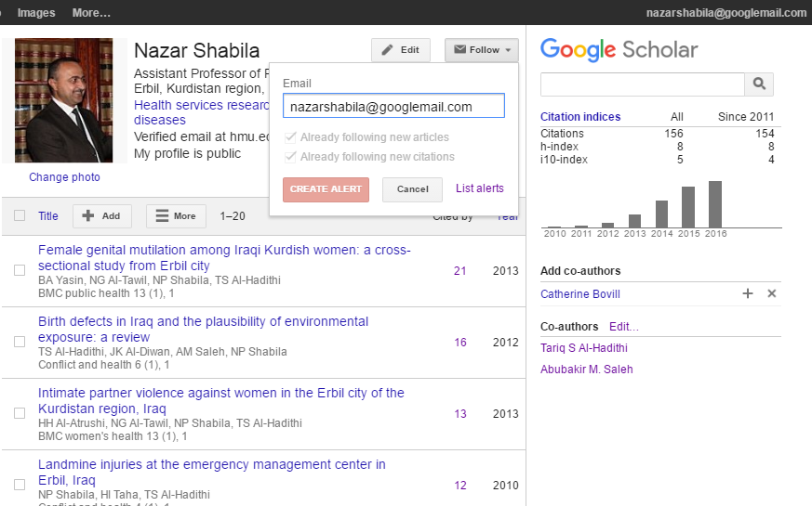
Create alerts (optional)

Slide 15
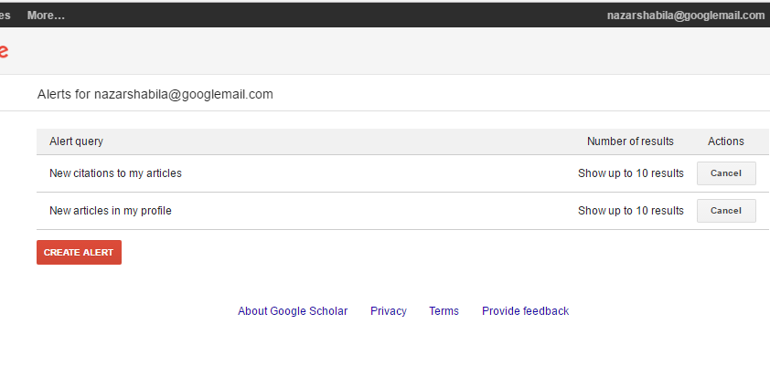
Create alerts (optional)

Slide 16
Add co-authors

Slide 17
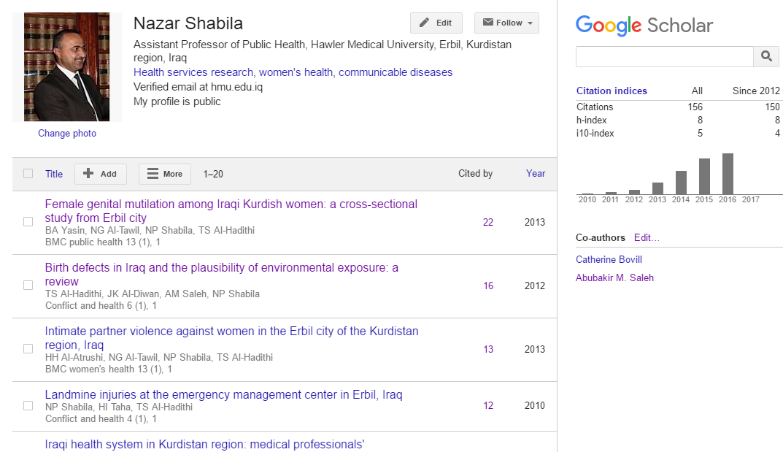
View who cited your work

Slide 18
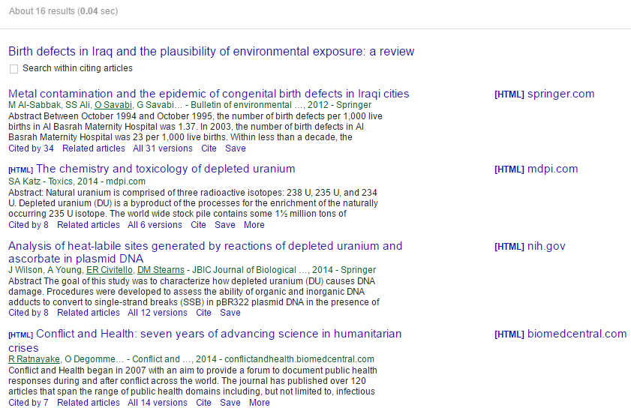

Slide 19
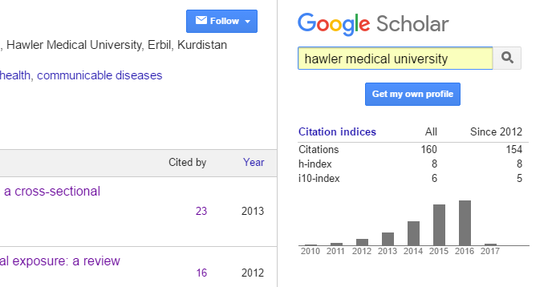
Search – Researchers or universities

Slide 20
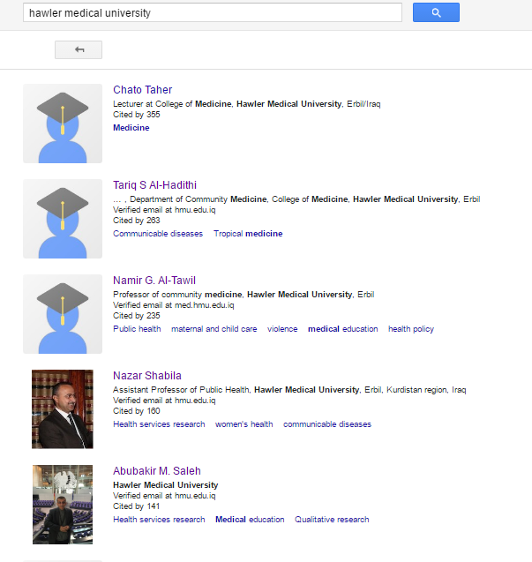

Slide 21
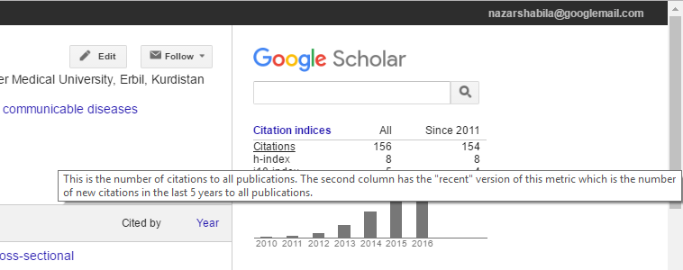
Citation indices: Citations
Citations: This is the number of citations to all publications. The second column has the “recent” version of this metric which is the number of new citations in the last 5 years to all publications.

Slide 22
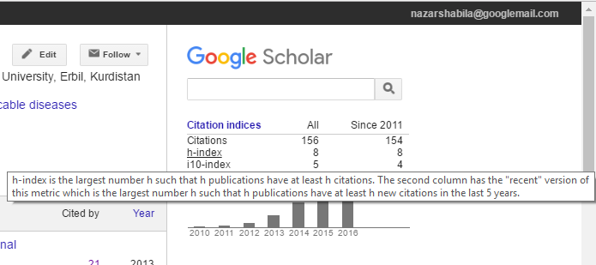
Citation indices: h-index
h-index: is the largest number h such that h publications have at least h citations. The second column has the “recent” version of this metric which is the largest number h such that h publications have at least h new citations in the last 5 years.
Productivity + Citation impact

Slide 23
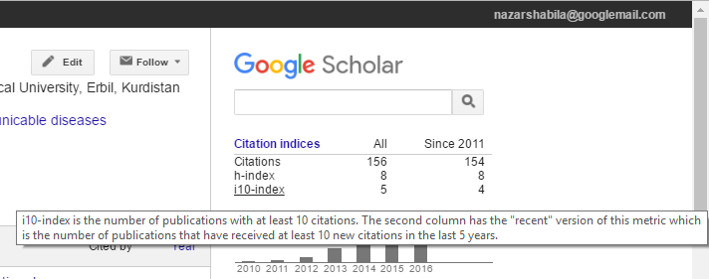
Citation indices: i10-index
i10-index: is the number of publications with at least 10 citations. The second column has the “recent” version of this metric which is the number of publications that have received at least 10 new citations in the last 5 years.

Slide 24
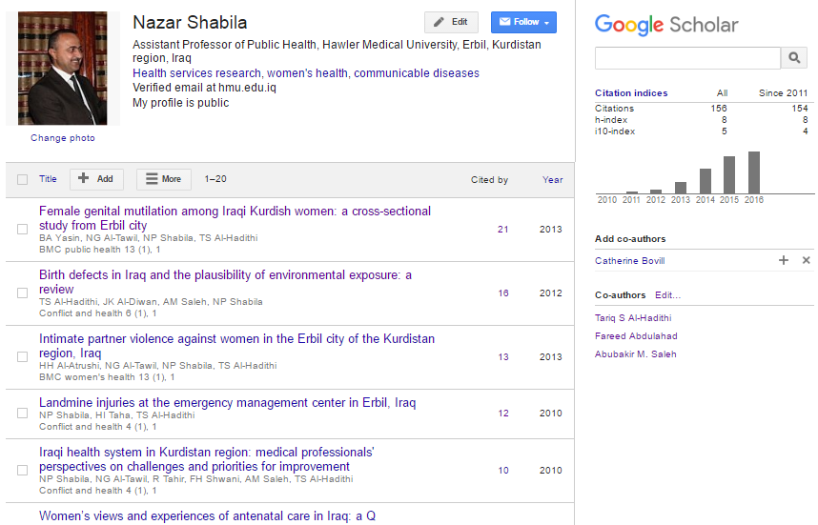
- Articles will be added automatically in future - But you can check and add new articles

Slide 25
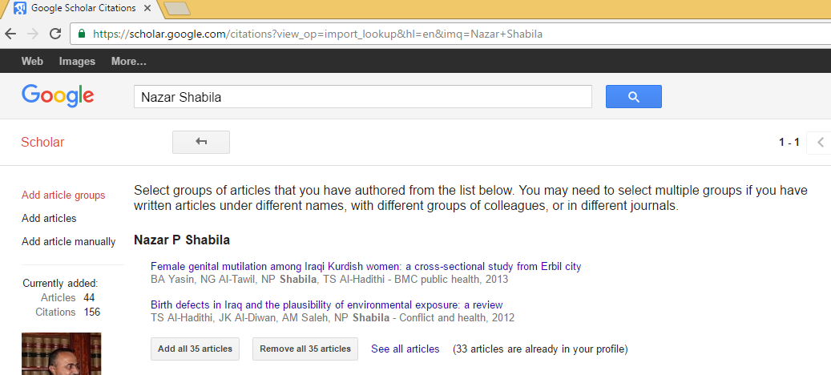
Check and add new articles

Slide 26
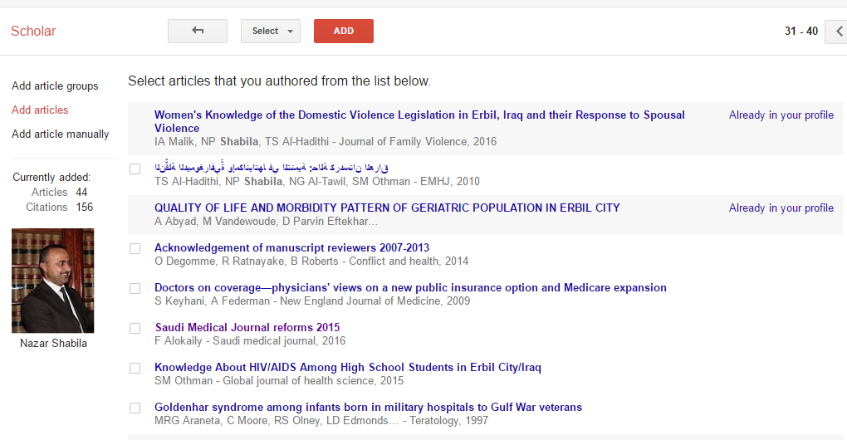
Check and add new articles

Slide 27
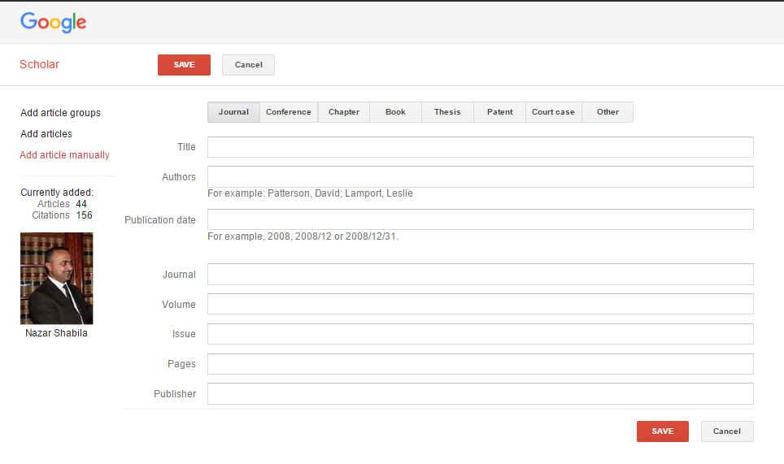
Add your articles manually

Slide 28
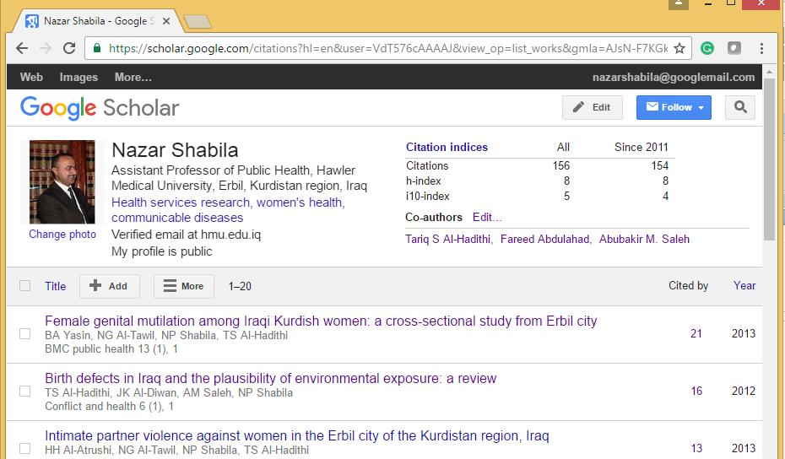
Delete your account

Slide 29
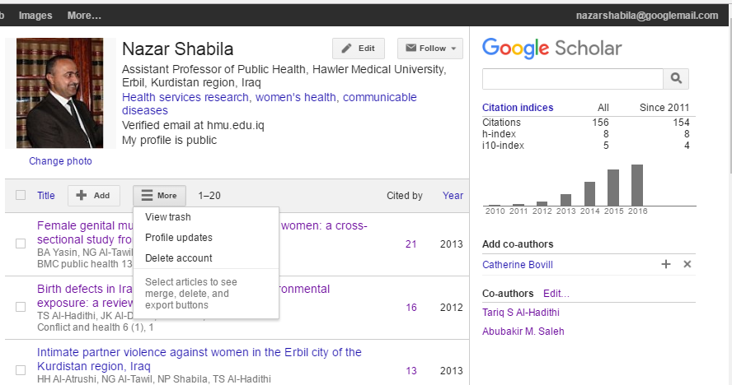
Delete account

Slide 30
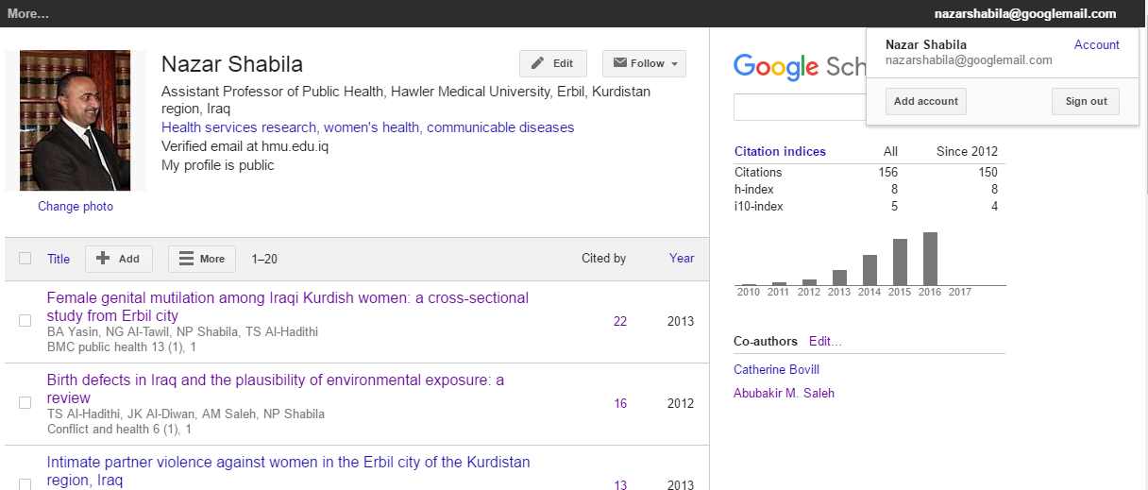
Sign in and Sing out

Slide 31
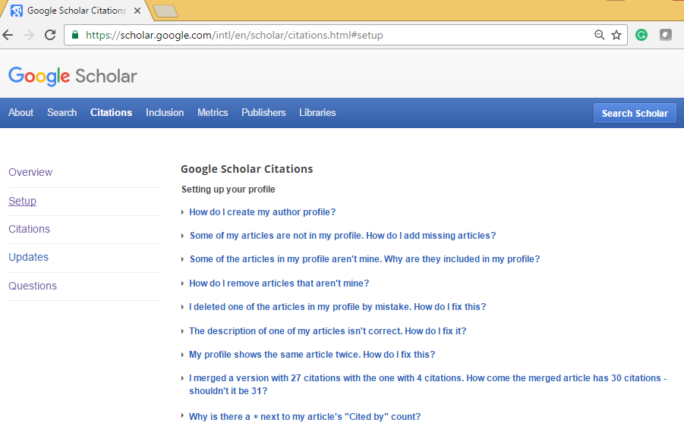
More information …

